Slide 1
UNIT 1- PROGRAMMING FUNDAMENTALS
UNIT 1.3: WHAT ARE CONDITIONALS, IF/ELSE CONDITIONALS, WHAT ARE LOOPS, DIFFERENT LOOPS: FOR LOOP, WHILE LOOP

Slide 2
Learning Objectives
At the end of this unit, students will be able to
Define conditionals
Identify and use some of the conditionals
Describe loops
Identify various loops

Slide 3
Conditionals
In programming, Conditionals perform different operations based on the given condition

Slide 4
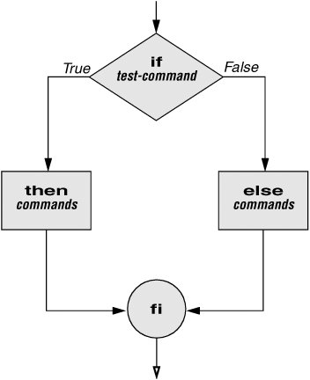
IF ELSE
This conditional is used to test two conditions
If (x = 10): do this
Else: do this
Notes:
Conditionals
http://tldp.org/HOWTO/Bash-Prog-Intro-HOWTO-6.html
Bash conditional examples
http://www.thegeekstuff.com/2010/06/bash-conditional-expression

Slide 5
Task
Write a statement that tells if an integer is positive or negative

Slide 6
Task
//is it a positive integer or negative
//var integer = 9;
var integer = -9;
if (integer > 0){
console.log("you entered a positive number");
}
else{
console.log ("you entered a negative number");
}

Slide 7
Task
change the value of the var
save & open it again

Slide 8
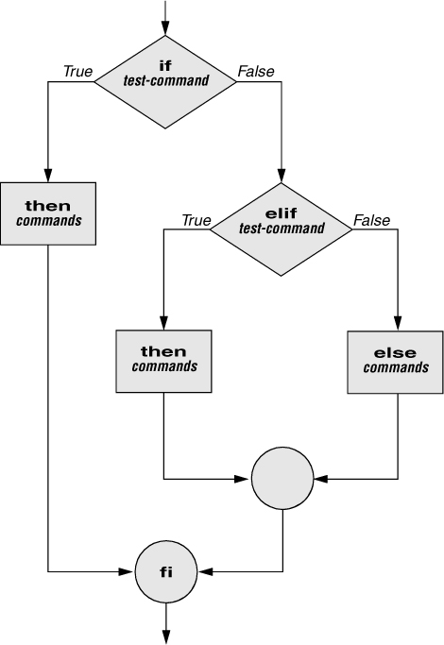
Nested IF-ELSE
Is used to test more than just two conditions
Structure looks like this:
Notes:
If statement examples
http://www.thegeekstuff.com/2010/06/bash-if-statement-examples/

Slide 9
Resources
http://www.thegeekstuff.com/2010/06/bash-if-statement-examples/
Notes:
If statement examples
http://www.thegeekstuff.com/2010/06/bash-if-statement-examples/

Slide 10
Task – Nested If-Else
Modify the script from previous if/else statement
Add another statement to check if the number is greater than 100
Add an else statement (when number isn’t greater or smaller than 100)
Notes:
Bash If Statement Examples
http://www.thegeekstuff.com/2010/06/bash-if-statement-examples/

Slide 11
Task – Nested If-Else
if (integer > 0){
if (integer > 100){
console.log("positive integer. greater than 100");
}
else if(integer < 100){
console.log("positive integer. Less than 100")
}
}
else(integer < 0){
console.log("negative integer")
}
Notes:
Bash If Statement Examples
http://www.thegeekstuff.com/2010/06/bash-if-statement-examples/

Slide 12
Task
Write a statement that tells if integer is < 100
If yes, is it positive or negative?
Remember to declare your global var
Notes:
Bash If Statement Examples
http://www.thegeekstuff.com/2010/06/bash-if-statement-examples/

Slide 13
Task
if(integer < 100){
if (integer > 0){
console.log("integer is less than 100. integer is positive");
}
else{
console.log("integer less than 100. negative integer");
}
}
Notes:
Bash If Statement Examples
http://www.thegeekstuff.com/2010/06/bash-if-statement-examples/

Slide 14
Task
What is your letter grade?
If student gets 90 or higher: they get an A
If students get 80 or above: they get a B
If students get 70 or above: they get a C
If students get 55 or above: they get a D
Any grade lower than 55 is F

Slide 15
Task
console.log("task: what is your letter grade");
var grade = 80;
if (grade >= 90){
console.log(" You got an A"); }
else if (grade >= 80 && grade < 90){
console.log("you got a B");}
else if (grade >= 70 && grade < 80){
console.log("You got a C"); }
else if(grade >=55 && grade< 70){
console.log("You got a D"); }
else if (grade < 55 && grade >= 0){ // to ensure non negative number
console.log("You failed"); }

Slide 16
Intro to Loops

Slide 17
What is a loop
A sequence of instructions that are repeated for either certain number of times or until a condition is met

Slide 18
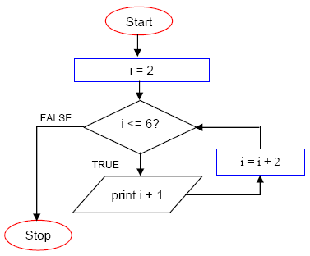
For Loop- Structure
It has a start number
It has an end number
Loop runs from start to end
check resources
Notes:
Loops
http://tldp.org/HOWTO/Bash-Prog-Intro-HOWTO-7.html
For Loop
https://bash.cyberciti.biz/guide/For_loop

Slide 19

For loop in JavaScript
The for loop has the following syntax:
Statement 1 is executed before the loop (the code block) starts
Statement 2 defines the condition for running the loop (the code block)
Statement 3 is executed each time after the loop (the code block) has been executed.

Slide 20
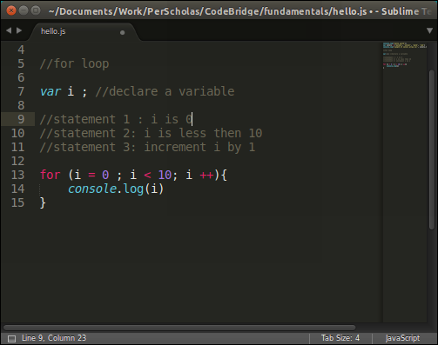
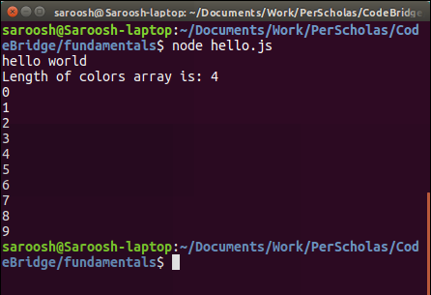
For Loop is JavaScript cont.

Slide 21
For Loop
console.log("task: for loop to print numbers 1 through 10”);
for (var i = 1 ; i <=10 ; i++){ //note: a variable can be declared within a for loop
console.log( i );
}

Slide 22
For Loop
Replace var for const
see what happens?
Notes:
Instructor Notes: New values cannot be assigned when using const.

Slide 23
For Loop - count down
Write a for loop that counts down from 10 to 1.

Slide 24
For Loop
console.log("task: for loop to countdown 10 -1”);
for (var i = 10 ; i > 0 ; i = i -1){ //note: a variable can be declared within a for loop
console.log( i );
}

Slide 25
Task - output exercise
output :
1, 3, 5, 7, 9
2, 4, 6, 8, 10

Slide 26
Task - Multiples Of Three
create a loop that outputs multiples of 3. starting at 6. ending at 60.

Slide 27
Task - Multiples Of Three
console.log("task: for loop to print multiples of 3");
//following is one way of doing it
for (var i = 2 ; i <= 60 ; i++){
console.log(3*i);
}

Slide 28
Task - Looping a Triangle
Write a for loop that outputs the following.
Output:
#
##
###
####
#####
######
#######
########

Slide 29
Task - Looping a Triangle
let word = "#"; console.log(word); for (i = 0; i < 7; i++) { word = word + "#"; console.log(word); }

Slide 30
Remainder Operator %
The remainder operator returns the remainder left over when one operand is divided by a second operand. It always takes the sign of the dividend.
4 % 3
returns 1
20 % 2
returns 0
20 % 9
returns 2

Slide 31
Print Even #’s
Using the remainder % operator, write a for loop that iterates between 0 and 10 and prints all even numbers.

Slide 32
Print Even #’s
for (i = 0; i <=10; i++) { if( i % 2 == 0) { console.log(i);
} }

Slide 33
Challenge
Write a for loop that iterates from 1- 20. Prints “prime” for all prime numbers, “even” for all even numbers, and “odd” for all odd numbers.[Treat 2 as an even number and 1 & 3 as odd]

Slide 34
Resources
https://developer.mozilla.org/en-US/docs/Web/JavaScript/Reference/Operators/Arithmetic_Operators

Slide 35
Unit HW
Code Academy : steps 3 - 5
Sign up for an account on CSX:
https://csx.codesmith.io/
Complete challenges:
Challenge: For Loops
Challenge: For Loops and Arrays
Challenge: For Loops and Array Indices
Challenge: For Loops - Calculating Array Elements

